Slide 1

Vote Counting
NATIONAL INSTITUTE OF TECHNOLOGY HAMIRPUR
Presented to:
Dr. Robin Singh Bhadoria
Presented By:
Akshant Verma 21DCS015

Slide 2
01
02
03
04
05
06
Table of Contents
Introduction
Project Objectives
Literature Review
Embedded Components
Circuit Diagram
Methodology
09
08
Results & Outputs
Conclusion & Future Works

Slide 3
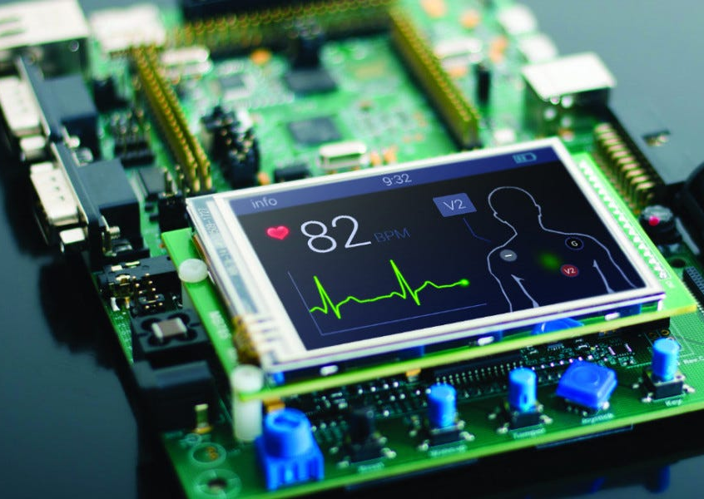
INTRODUCTION
What Are Embedded Systems?
Definition: Small, specialized computers embedded into devices to perform dedicated tasks (unlike general-purpose PCs).
Examples: Medical devices, smartwatches, IoT gadgets.
What is Vote Counting?
Process of tallying votes after an election.
Critical for democracy and transparency.

Slide 4
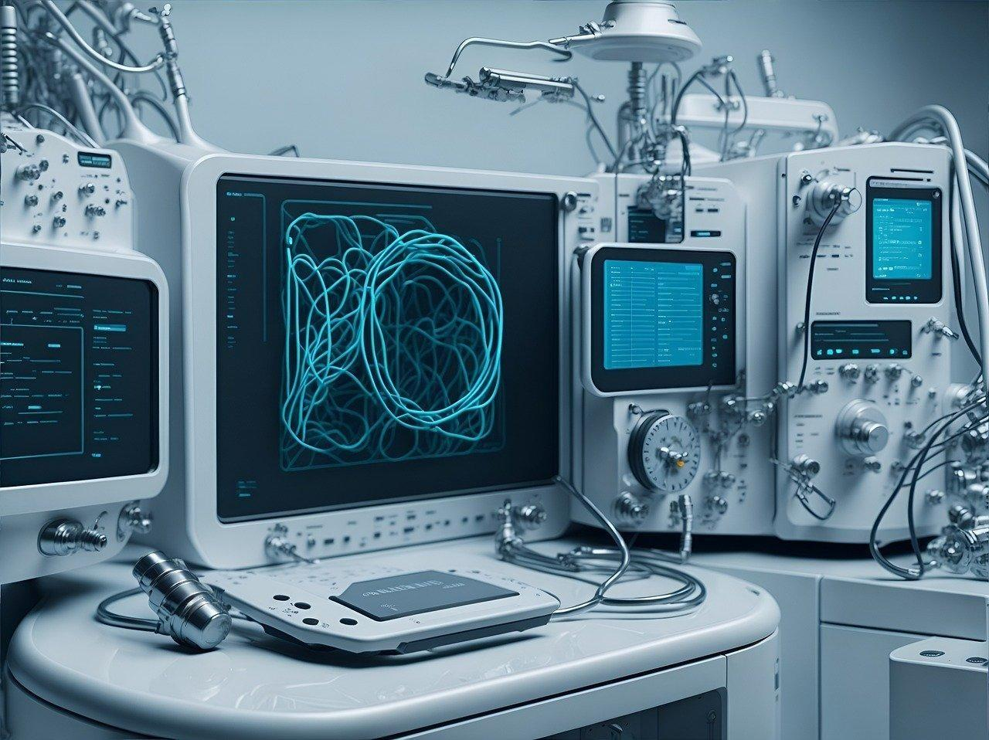
Project Objectives
The primary objective of this project is to design and simulate an electronic voting machine (EVM) using a Raspberry Pi Pico microcontroller
Key Goals
Simulate a realistic voting process using physical push-button inputs for multiple political parties
Accurately count and store votes cast for each candidate/party in real time
Display vote counts and declare the winner using a 16x2 LCD display.

Slide 5
1. Hardware:
Raspberry Pi Pico (Microcontroller)
Push Buttons (x4)
16x2 LCD Display (I2C Module)
Resistors
Breadboard and Jumper Wires.
Embedded System Components

Slide 6
2. Software Components:
MicroPython (Programming Language)
Wokwi Simulation Environment
I2C LCD Library
Embedded System Components

Slide 7
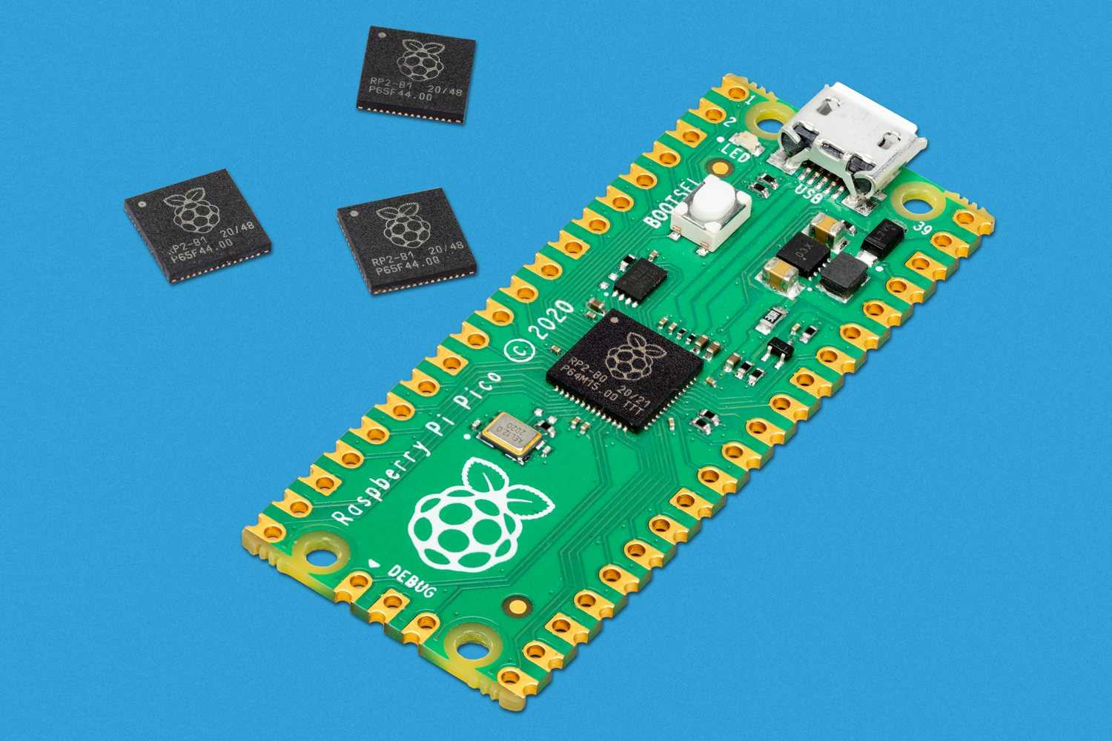
Function: Raspberry Pi Pico acts as the central controller that reads votes, processes counting logic, and displays results in the voting machine simulation. Role in Project: 1.Reads input from push buttons representing votes. 2.Executes vote counting logic in real-time. 3.Controls the display of vote counts on the LCD screen. 4.Coordinates with other components (LCD, buttons) via GPIO pins.
Raspberry Pi Pico (Microcontroller)

Slide 8
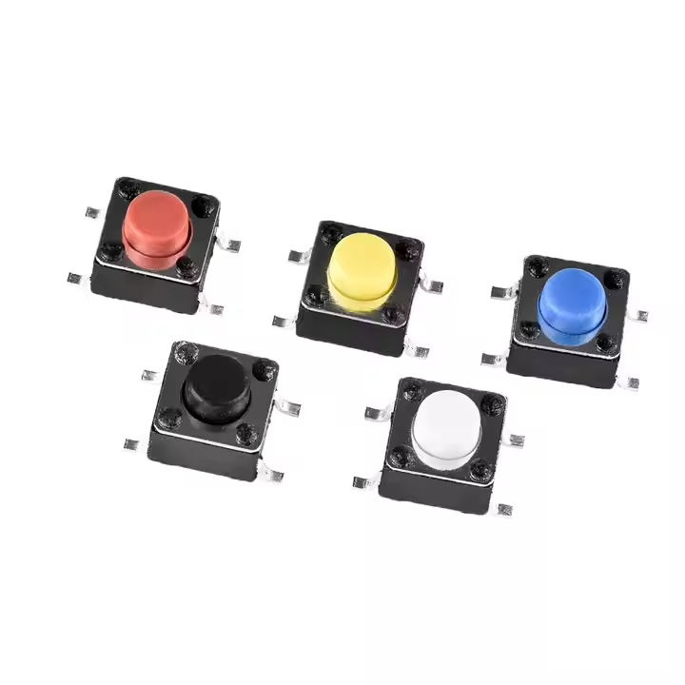
Function: Used to simulate voting by registering input when pressed. Role in Project: 1.Each button represents a different candidate. 2.Sends a signal to the microcontroller when pressed. 3.Allows users to cast votes in the simulation 4.Enables real-time, manual vote input for demonstration
Pulse/Temperature Sensors

Slide 9
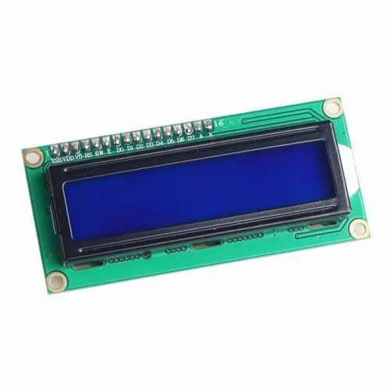
Function: Displays real-time vote counts and messages from the microcontroller. Role in Project:
I2C LCD DISPLAY (16x2)
Displays the vote count for each party.
Shows the total votes and declares the winner.
Uses I2C protocol to communicate with the Pico (SDA/SCL pins)

Slide 10
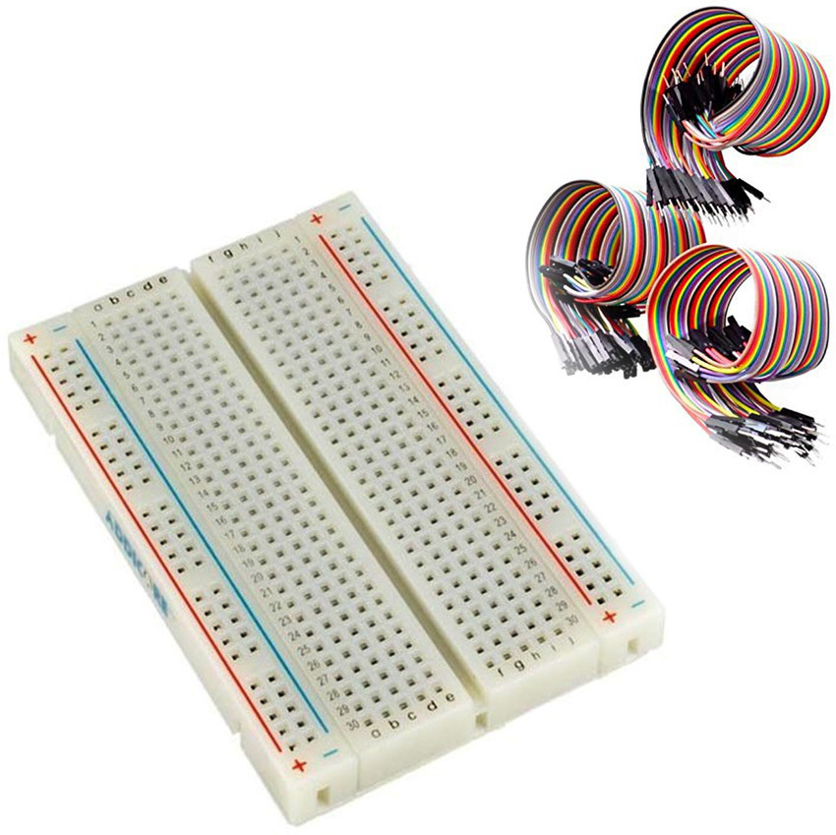
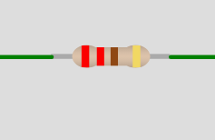
Breadboard: Role: Facilitate electrical connections and signal routing between components without soldering. Resistors: Role: Limit current to protect components like LEDs and microcontroller pins. Jumper Wires: Role: Connect different components and pins on the breadboard and Pico.
Breadboard,resistor and Jumper Wires

Slide 11
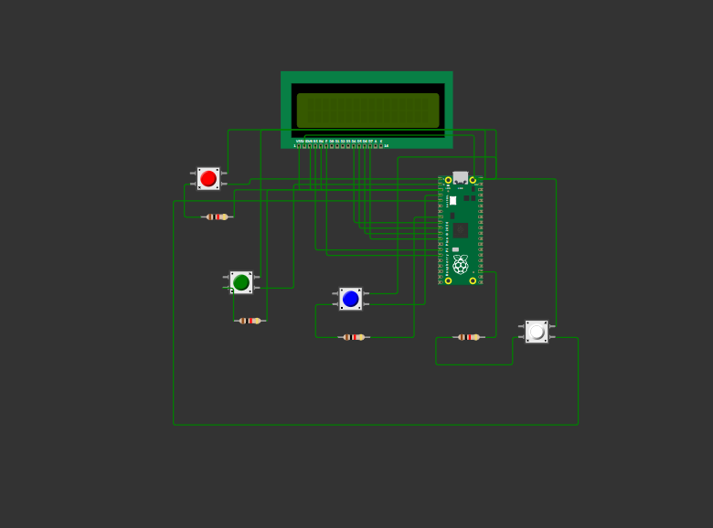
Circuit Diagram

Slide 12
Methodolody
1. System Design
Designed a voting system circuit using Raspberry Pi Pico.
Included four push buttons (representing four candidates) as input devices.
Integrated a 16x2 I2C LCD to display vote counts and messages.
Used breadboard and jumper wires for circuit connections.
2. Hardware Setup
Connected push buttons to GPIO pins on the Pico.
LCD connected via I2C protocol (SDA & SCL pins).
Pull-down resistors used for button debouncing and stable input signals.
3. Software Development
Written in MicroPython using the Wokwi simulator.
Defined GPIO pin modes, interrupt logic, and LCD display functions.
Implemented a real-time vote counting algorithm.
4. Simulation and Testing
Uploaded and tested the code on Wokwi virtual environment.
Verified button presses increment corresponding candidate votes.
Ensured LCD updates accurately reflect vote counts.

Slide 13
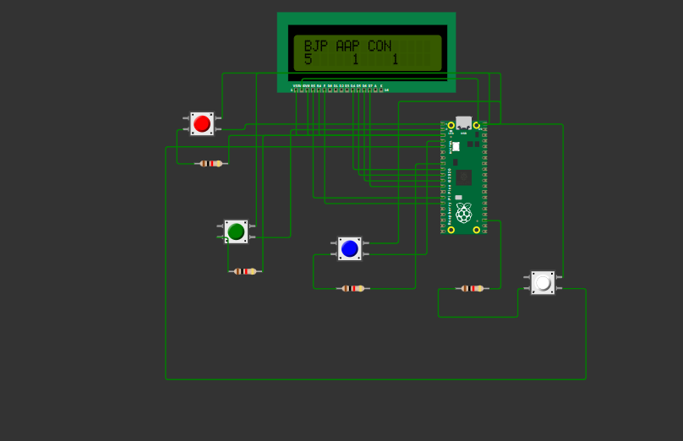
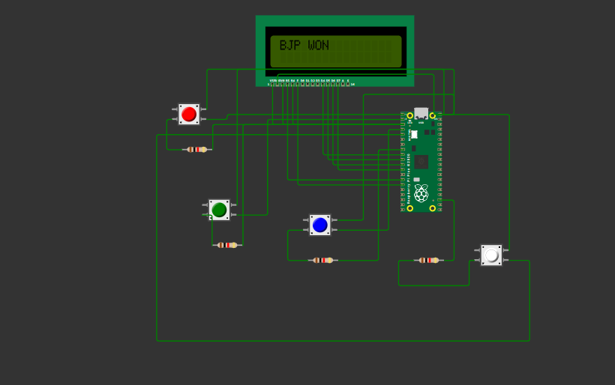
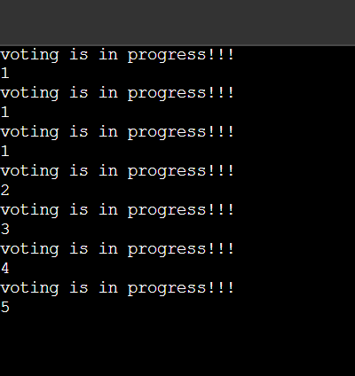
Results & Outputs

Slide 14
Conclusion & Future Works
Conclusion
Developed a functional voting simulation system using Raspberry Pi Pico and MicroPython.
Successfully demonstrated real-time vote counting using push buttons and live display via 16x2 I2C LCD.
Validated circuit accuracy, stability, and reliability through simulation in Wokwi.
Project proves how embedded systems can offer low-cost, portable, and customizable solutions for vote management.
Future Works
Add a secure voting authentication system (e.g., using RFID or fingerprint sensor).
Store results in non-volatile memory (e.g., EEPROM or SD card).
Develop wireless data transfer (e.g., using Wi-Fi or Bluetooth module).
Expand to multiple polling stations with centralized result collection.
Upgrade the user interface with a touchscreen display for better usability.
Implement result encryption for security and privacy in real-world applications.

Slide 15
References
Wokwi
Project Link: https://wokwi.com/projects/422762967881081857
Wokwi Official: https://wokwi.com
Raspberry Pi Pico Documentation https://www.raspberrypi.com/documentation/microcontrollers/pico-series.html
MicroPython Official Documentation https://docs.micropython.org/en/latest/rp2/quickref.html
LCD1602 I2C Display Guide https://randomnerdtutorials.com/esp32-i2c-lcd-1602-display-arduino-ide/
Push Button Debounce and Digital Input Concepts https://www.electronics-tutorials.ws/switches/switch_4.html
YouTube Tutorials for Beginners
https://www.youtube.com/watch?v=zlKJ5hvfs6s&ab_channel=Electronoobs
https://www.youtube.com/watch?v=jqhILdtZg9s&ab_channel=ChakriChowdhary

Slide 16
Github repo link
https://github.com/Rameshsain070/voting-machine

Slide 17
THANK YOU :)

